Slide 1

Algorithms and Data Structures 1 CS 0445
Fall 2023
Designing Recursive Solutions
Sherif Khattab
ksm73@pitt.edu
(Some Slides are adapted from the Textbook’s and Dr. Ramirez’s CS 0445 slides.)

Slide 2
Announcements
Upcoming Deadlines:
Homework 6: Tuesday 10/17 @ 11:59 pm
Programming Assignment 2: Friday 10/20 @ 11:59 pm
Lost points in a lab assignment because of the autograder or a simple mistake?
please reach out to Grader TA over Piazza
OMET Midterm Survey
Live code

Slide 3
So far on Recursion …
Remember the counting down and the sum of integers activities?
We have seen how recursion works
Each person represented a recursive call with an activation record on the Runtime Stack
A recursive solution has:
One or more Base Cases: a problem instance that one can solve without help
One or more Recursive Cases: do a bit of work and ask a friend for help
Each Recursive Case must lead to a Base Case
Otherwise, we get infinite recursion

Slide 4
A Recipe for Designing Recursive Solutions
Define the problem at hand
What are the input(s) and output(s)
Find a Base Case:
What is an input that you can solve yourself
without asking for friends’ help
Define a Recursive Case:
Imagine a friend who can solve the problem at hand
You can’t ask them for help with the original problem
Find one or more smaller problems (subproblems) to ask your friend to solve
Given your friend’s solutions, how can you solve the original problem?
Revisit the inputs to the problem given what your friend needs to define subproblem

Slide 5
Example: Recursively Displaying an Array
Define the problem at hand
Inputs: an array of a specific size
Output: displaying the array entries
Base Case:
What is an input that you can solve yourself
An empty array?
An array with a single entry (singleton)?
Recursive Case:
Imagine a friend who can display an array
You can’t ask them for help with the original array
Find one or more smaller problems (subproblems) to ask your friend to solve
Ask your friend to display each half of the array

Slide 6
Example: Recursively Displaying an Array
Define the problem at hand
Base Case:
Recursive Case:
…
Given your friend’s solutions, how can you solve the original problem?
Divide the array into two subarrays with (almost) equal size
Ask a friend to display 1st half
Ask a friend to display 2nd half
How can we pass a subarray to our friend?
Create a new smaller array and copy half the entries (time and space overhead)
Use the same array but pass first and last positions for the half (Better!)

Slide 7
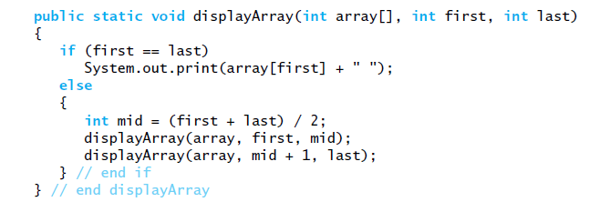
Recursively Displaying an Array
Base Case: How do we know if the subarray has one entry?
first == last

Slide 8

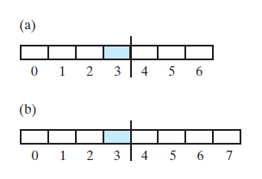
Recursively Displaying an Array
Recursive Case: How to split an array into halves given first and last?

Slide 9
Recursively Displaying an Array
Recursive Case
Consider first + (last – first) / 2 Why?

Slide 10
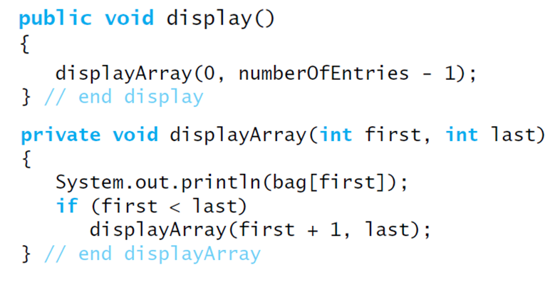
Displaying a Bag
Define a private Recursive method that is part of the ArrayBag implementation of ADT Bag
Base Case?
Recursive Case?

Slide 11
Recursively Displaying a Linked Chain
Problem Definition?
Input: the first node of a chain (let’s call it nodeOne)
Output: display the data in all chain nodes
Base Case:
Empty chain
nodeOne == null
Action for Base Case:
Do nothing
Recursive Case:
Display first node
Call friend on rest of chain
What is the first node in “rest of chain”
nodeOne.next
Revisit input:
No need to pass in first and last

Slide 12
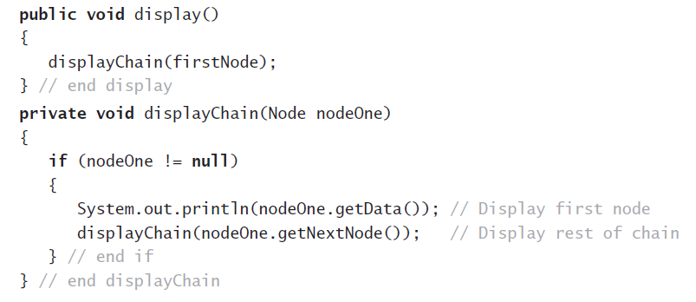
Recursively Displaying a Linked Chain
Base Case

Slide 13
Recursively Displaying a Linked Chain
Recursive Case
Display data in first node
Then, (recursively) display data in rest of chain

Slide 14
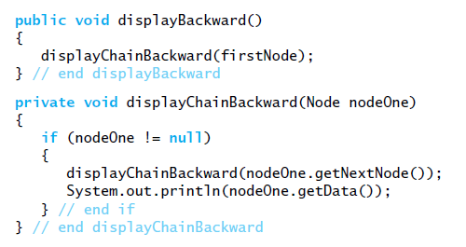
Traversing a linked chain backwards
Traversing a chain of linked nodes in reverse order is easier when done recursively.

Slide 15
Traversing a linked chain backwards
(recursively) display data in rest of chain

Slide 16
Traversing a linked chain backwards
(recursively) display data in rest of chain
Then, display data in first node

